Slide 1
Mini Capstone Project:
Crime Data Analysis with MySQL and Python
BY
Kuheli Das

Slide 2
Problem Statement:
For this project, we will be analysing the Crime data.
The main objective behind this project is to explore and analyze data to discover the places where crimes have taken place and give insights to the lawmakers who can use this information to identify areas where new laws or policies are needed, as well as to evaluate the effectiveness of existing laws. Crime data can help lawmakers determine which types of crimes are most prevalent in their jurisdiction, which populations are most affected by crime, and which interventions are most effective in reducing crime rates

Slide 3
Workflow
Data Collection and Understanding
Exploratory Data Analysis
Data Collection and Understanding:
After collection of data, it’s important to understand the structure of the data.We have Crime Analysis data in which total number of rows are 499 and number of columns are 13.
The dataset includes information such as DR NO, Date Reported, Date Occurred, Area Name, Crime Code, Crime Code Description, Victim Age, Victim Sex, Premises Description, Status, Location, Latitude, and Longitude.

Slide 4
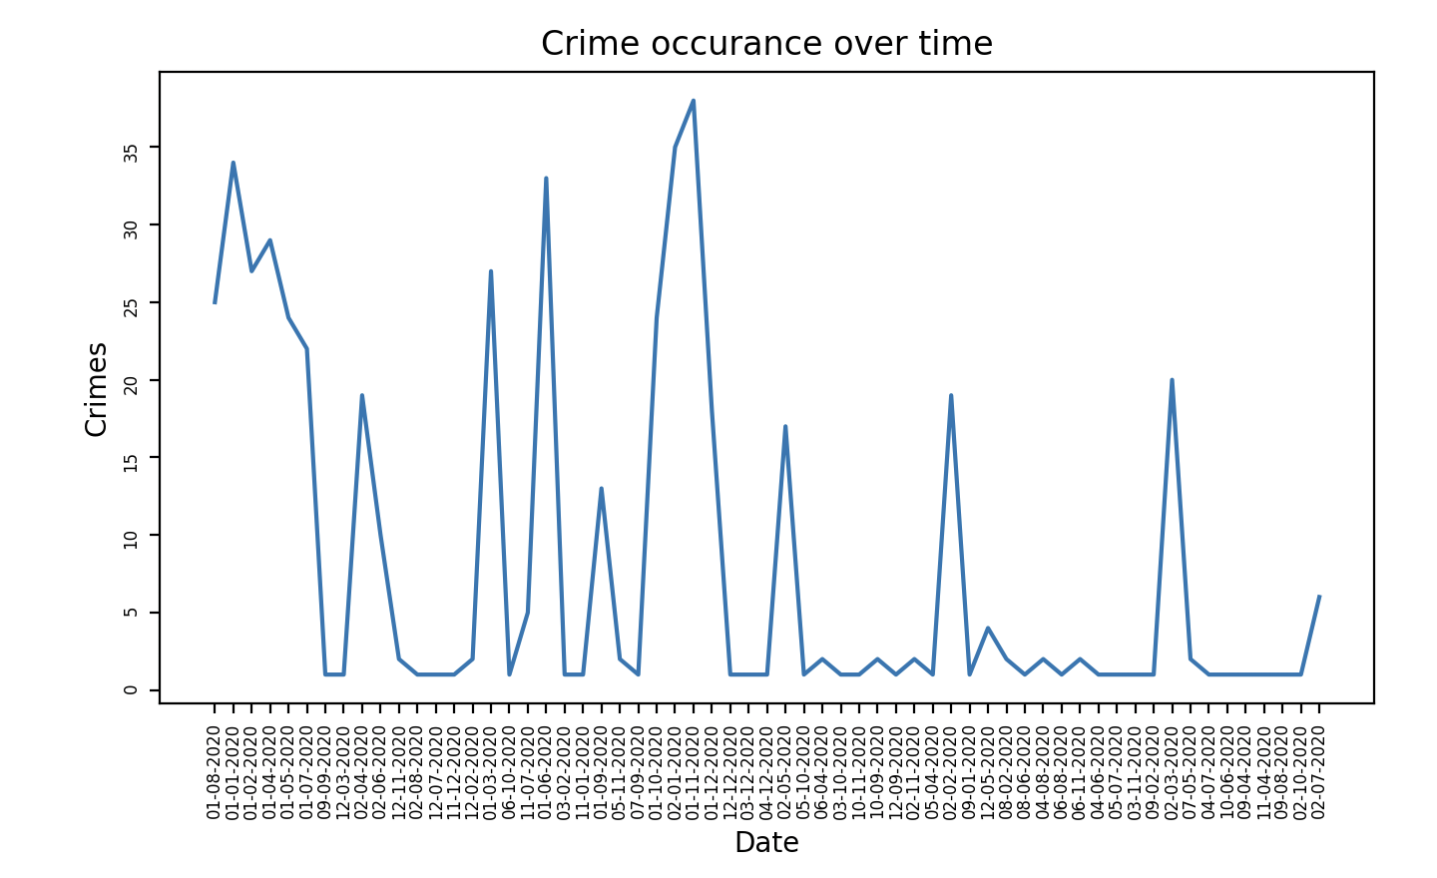
Exploratory Data Analysis
Temporal Analysis
Trends in crime occurrence over time.
Conclusion:
The graph shows crime numbers changing over time.
There are sharp rises and falls, suggesting crime spikes on certain dates.
The pattern is irregular, with no clear trend.
Peaks could be linked to specific events.

Slide 5
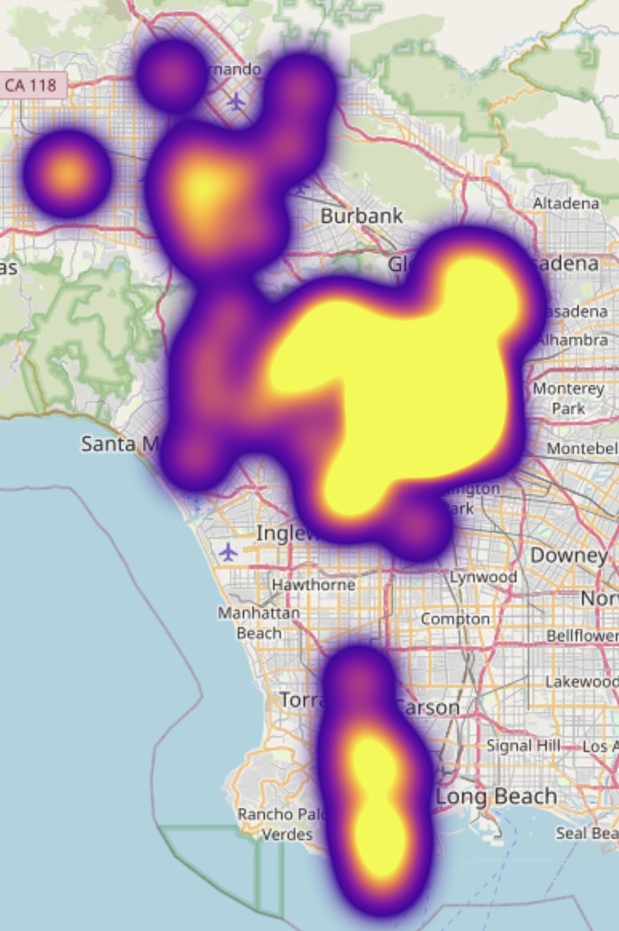
Spatial Analysis
Visualize crime hotspots on a map
Conclusion:
The map shows a heat map overlay on a geographic area.
Brighter colors indicate higher concentrations of data points, likely representing crime hotspots.
The largest hotspot appears in the central region, suggesting a high level of activity.
Smaller hotspots are scattered around, indicating other areas of concern.

Slide 6
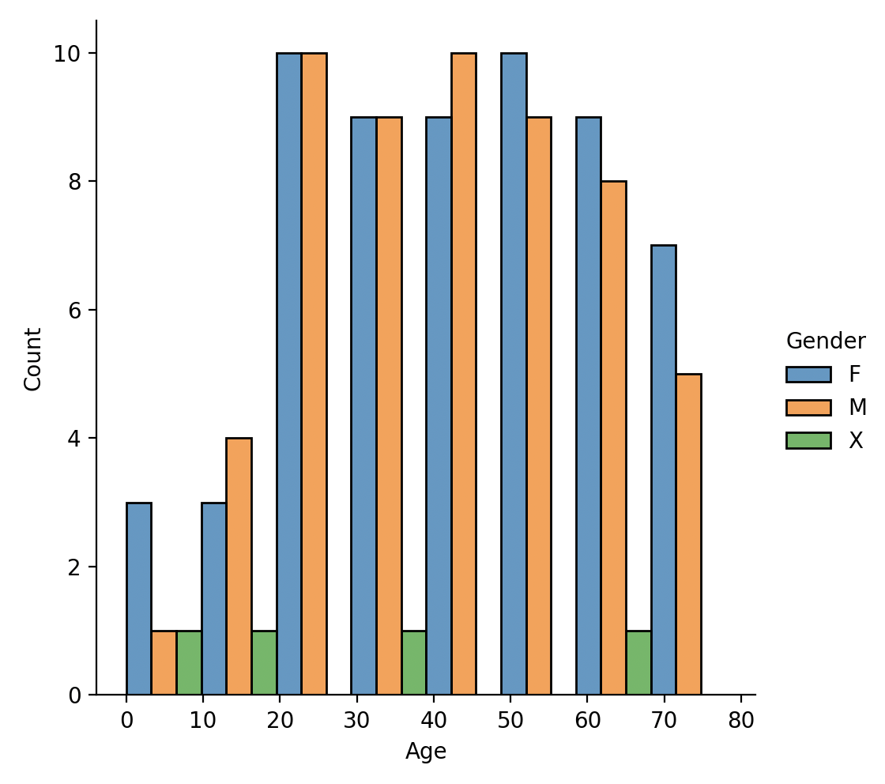
Victim Demographics:
Conclusion:
The chart displays ages of crime victims, divided by gender.
Male victims (in blue) are slightly more common than female victims (in orange).
Mostly crime is targeted between the age 20 - 50
Victims who are non-binary or unspecified (in green) are the least victims

Slide 7
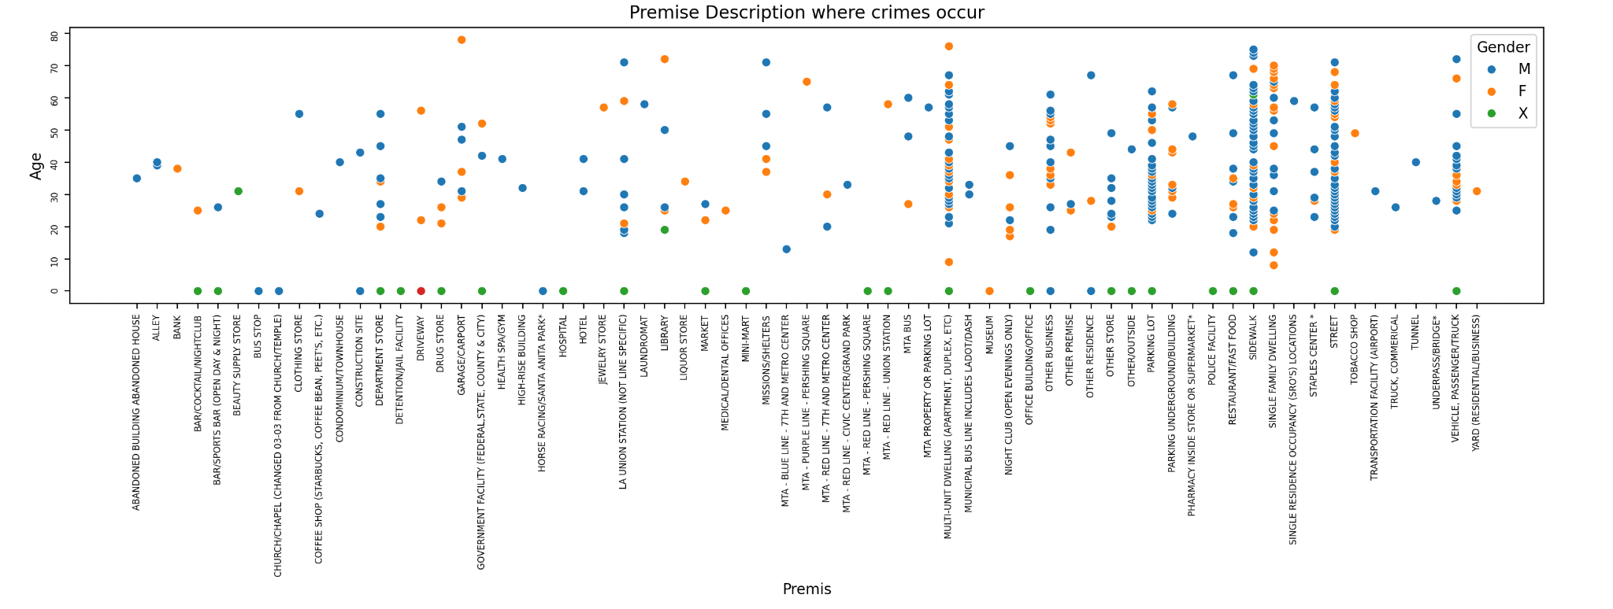
Victim Demographics (Premises descriptions where crimes occur)
Conclusion:
The scatter plot maps victim age against the premises where crimes occur, colored by gender.
Most crimes occur at premises like Multi-unit dwellings,sidewalk,street, parking lot and other businesses.
Victims aged between 20 and 50 are most common across all premise types.
Males (blue dots) are the most common victims in most premise types.
Non-binary or unspecified gender victims (green dots) are less frequent but present across premises.
The chart helps identify which areas may need more security measures.

Slide 8
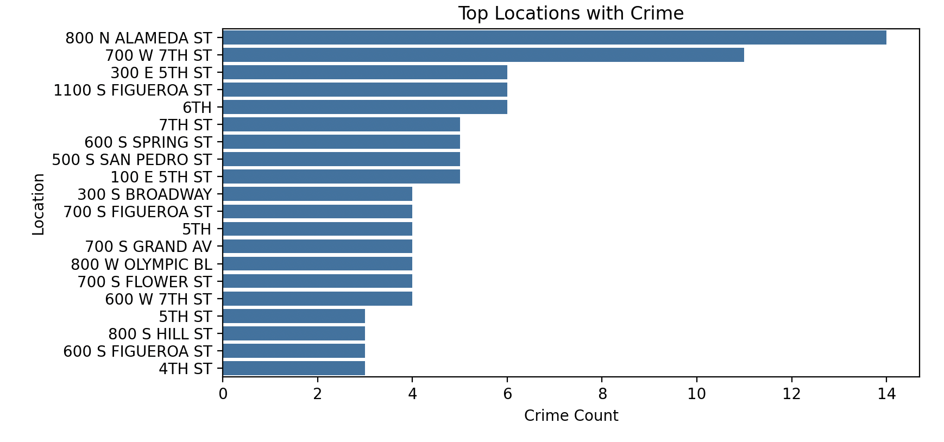
Location Analysis:
Crimes occur based on the "Location" column
Conclusion:
The horizontal bar chart ranks locations by crime count.
800 N Alameda St. has the highest number of reported crimes.
Crime counts decrease as we move down the list of locations.
Most locations have between 2 to 14 reported crimes.
The chart helps identify which areas may need more security measures.

Slide 9
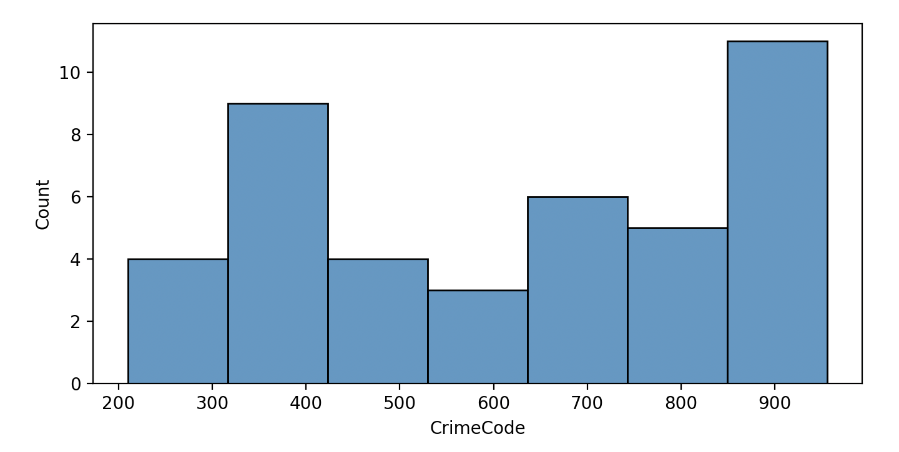
Crime Code Analysis:
Distribution of reported crimes based on Crime Code
The histogram displays the count of crimes for different crime codes.
Crime codes of 900 have the highest crime count
There is a lower frequency of crimes with codes near 500 and 800.
The distribution suggests certain types of crimes are more common than others.
Understanding the codes with higher counts can prioritize preventive measures.

Slide 10
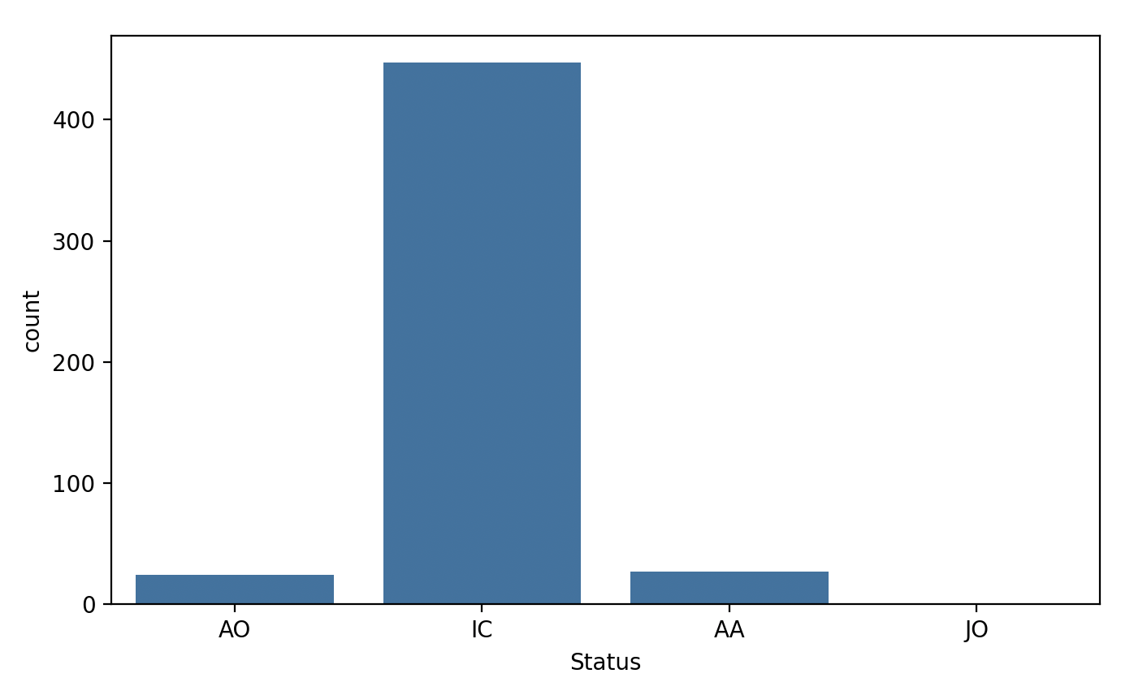
Status Analysis:
Classifying crimes based on their current status
The chart highlights the distribution of cases across four statuses: AO, IC, AA, and JO.
'IC' status dominates the dataset, indicating most cases are in this category.
There is a stark contrast between the 'IC' status and the others, suggesting a potential backlog
AO', 'AA', and 'JO' statuses are relatively rare in comparison
Understanding the reasons behind the 'IC' status prevalence may improve case processing efficiency.

Slide 11
THANK YOU

